Slide 1
Data Structures and Algorithms
Graphs:
Breadth-First and Depth-First Search
Mark Allen Weiss: Data Structures and Algorithm Analysis in Java

Slide 2
Objectives
Students will learn about
  Traversing a Graph using
  Breadth-first Search
  Depth-first Search
  Complexity and Performance comparison

Slide 3
Breadth-First and Depth-First Search
BFS Basic Algorithm
BFS Complexity
DFS Algorithm
DFS Implementation
Relation between BFS and DFS

Slide 4
Breadth-First search
This strategy operates by processing vertices in layers: The vertices closest to the start are evaluated first, and the most distant vertices are evaluated last.
This is much the same as a level-order traversal for trees.
This strategy for searching a graph is known as breadth-first search.

Slide 5
BFS – Basic Idea
Given a graph with N vertices and a selected vertex A:
for (i = 1; there are unvisited vertices ; i++)
Visit all unvisited vertices at distance i
(i is the length of the shortest path between A and currently processed vertices)
Queue-based implementation

Slide 6
BFS – Algorithm
BFS algorithm
1. Store source vertex S in a queue and mark as processed
2. while queue is not empty
Read vertex v from the queue
for all neighbors w:
If w is not processed
Mark as processed
Append in the queue

Slide 7
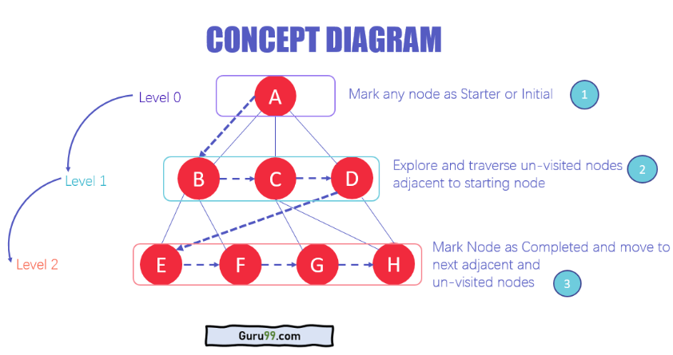
BFS

Slide 8
BFS – Example
1
4
2
3
5
6

Slide 9
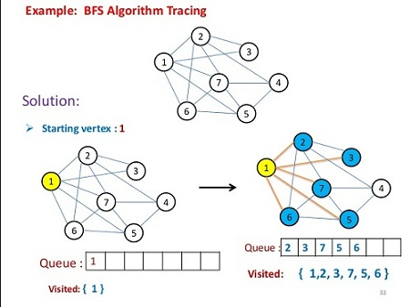
BFS

Slide 10
BFS – Example
1
4
2
3
5
6
1, 2, 3, 4, 6, 5

Slide 11
Example
Breadth-first traversal: 1, 2, 3, 4, 6, 5
1: starting node
2, 3, 4 : adjacent to 1
(at distance 1 from node 1)
6 : unvisited adjacent to node 2.
5 : unvisited, adjacent to node 3
Adjacency lists
1: 2, 3, 4
2: 1, 3, 6
3: 1, 2, 4, 5, 6
4: 1, 3, 5
5: 3, 4
6: 2, 3
1
4
2
3
5
The order depends on the order of the nodes in the adjacency lists
6

Slide 12
BFS in Tree – Example
H
D
L
B
F
J
N
A
C
E
G
I
K
M
O
H | D | L | B | F | J | N | A | C | E | G | I | K | M | O

Slide 13
Depth-First Search
Starting at some vertex, v, we process v and then recursively traverse all vertices adjacent to v.
Depth-first search is a generalization of preorder traversal.
Recursive in nature.

Slide 14
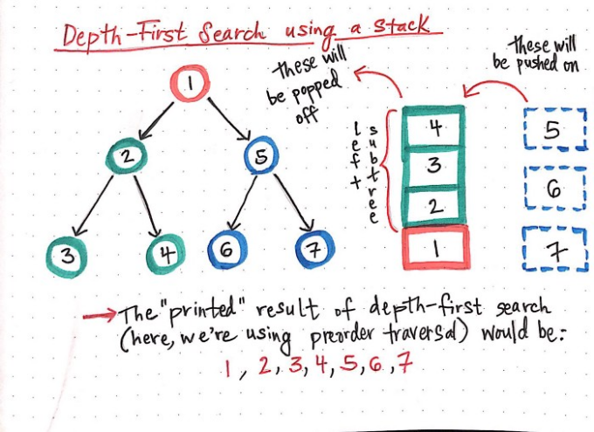

Slide 15
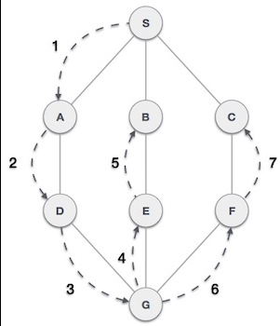
DFS

Slide 16

DFS – Algorithm
mark all vertices in the graph as not reached
invoke dfs on source node s
Procedure dfs (s)
mark and visit s
for each neighbor w of s
if the neighbor is not reached
invoke dfs(w)

Slide 17
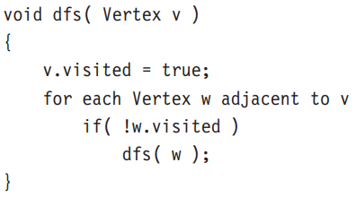
DFS – Algorithm

Slide 18
DFS – Example
1
4
2
3
5
6

Slide 19
DFS – Example
1
4
2
3
5
6
1, 2, 6, 3, 5, 4

Slide 20
Example
Depth first traversal: 1, 2, 6, 3, 5, 4
the particular order is dependent on the order of nodes in the adjacency lists
1
4
Adjacency lists
1: 2, 3, 4
2: 6, 3, 1
3: 1, 2, 6, 5, 4
4: 1, 3, 5
5: 3, 4
6: 2, 3
2
3
5
6

Slide 21
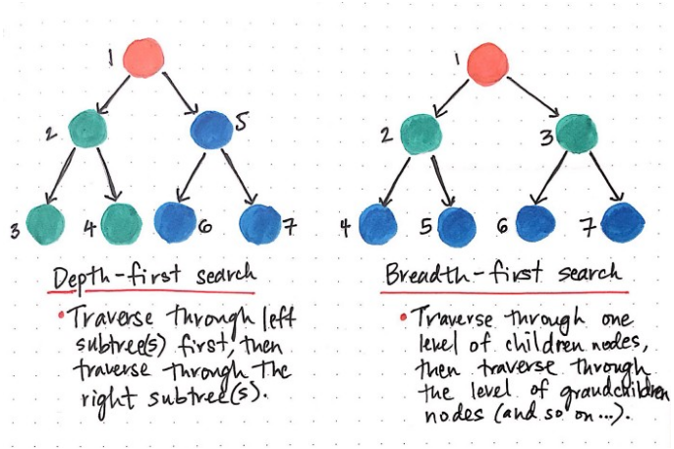
DFS & BFS

Slide 22
BFS & DFS Complexity
The Time complexity of both BFS and DFS will be
O(V + E)
where V is the number of vertices, and E is the number of Edges
Memory requirement for BFS is higher than DFS

Slide 23
Applications of DFS
Trees: preorder traversal
Graphs:
  Connectivity
  Biconnectivity – articulation points
  Euler graphs

Slide 24
Connectivity
Definition:
An undirected graph is said to be connected
if for any pair of nodes of the graph, the two nodes are reachable from one another (i.e. there is a path between them).
If starting from any vertex we can visit all other vertices, then the graph is connected

Slide 25
Biconnectivity
A graph is biconnected, if there are no vertices whose removal will disconnect the graph.
A
B
A
B
C
C
D
D
E
E
biconnected
not biconnected

Slide 26
Articulation Points
Definition: A vertex whose removal makes the graph disconnected is called an articulation point or cut-vertex
A
B
C is an articulation point
We can compute articulation points using depth-first search and a special numbering of the vertices in the order of their visiting.
C
D
E

Slide 27
Bridges
Definition:
An edge in a graph is called a bridge, if its removal disconnects the graph.
Any edge in a graph, that does not lie on a cycle, is a bridge.
Obviously, a bridge has at least one articulation point at its end, however an articulation point is not necessarily linked in a bridge.
A
B
C
D
(C,D) and (E,D) are bridges
E

Slide 28
Example 1
A
B
C
D
E
F
C is an articulation point, there are no bridges

Slide 29
Example 2
A
B
C
D
E
F
C is an articulation point, CB is a bridge

Slide 30
Example 3
D
A
G
B
C
F
E
B and C are articulation points, BC is a bridge

Slide 31
Example 4
A
B
C
D
E
B and C are articulation points. All edges are bridges

Slide 32
Example 5
A
B
C
D
E
F
G
Biconnected graph - no articulation points and no bridges

Slide 33
Connectivity in Directed Graphs (I)
Definition:
A directed graph is said to be strongly connected if for any pair of nodes there is a path from each one to the other
A
B
C
D
E

Slide 34
Connectivity in Directed Graphs (II)
Definition:
A directed graph is said to be unilaterally connected if for any pair of nodes at least one of the nodes is reachable from the other
A
B
Each strongly connected graph is also unilaterally connected.
C
D
E

Slide 35
Connectivity in Directed Graphs (III)
Definition:
A directed graph is said to be weakly connected if the underlying undirected graph is connected
A
B
Each unilaterally connected graph is also weakly connected
C
D
E
There is no path between B and D

Slide 36
Review Questions
Question 1:
What is a Bridge in a graph?
Question 2:
What are Biconnected graphs?

